Slide 1
PROJECT TITLE:
CREDIT CARD FRAUD DETECTION

Slide 2
PROBLEM STATEMENT
EU Bank is one of the largest banks issuing credit cards in the European sub-continent. EU Bank continuously looks to detect and prevent fraudulent transactions.EU Bank has obtained a large set of authentic data for transactions made by credit card in September 2013 by European cardholders. Out of 284,807 transactions, 492 (0.172%) transactions were found to be fraudulent.EU Bank wishes to develop an algorithm to prevent fraudulent transactions in future.

Slide 3
OBJECTIVE
The main objective of this project is to develop machine learning model to detect fraudulent
transactions.

Slide 4
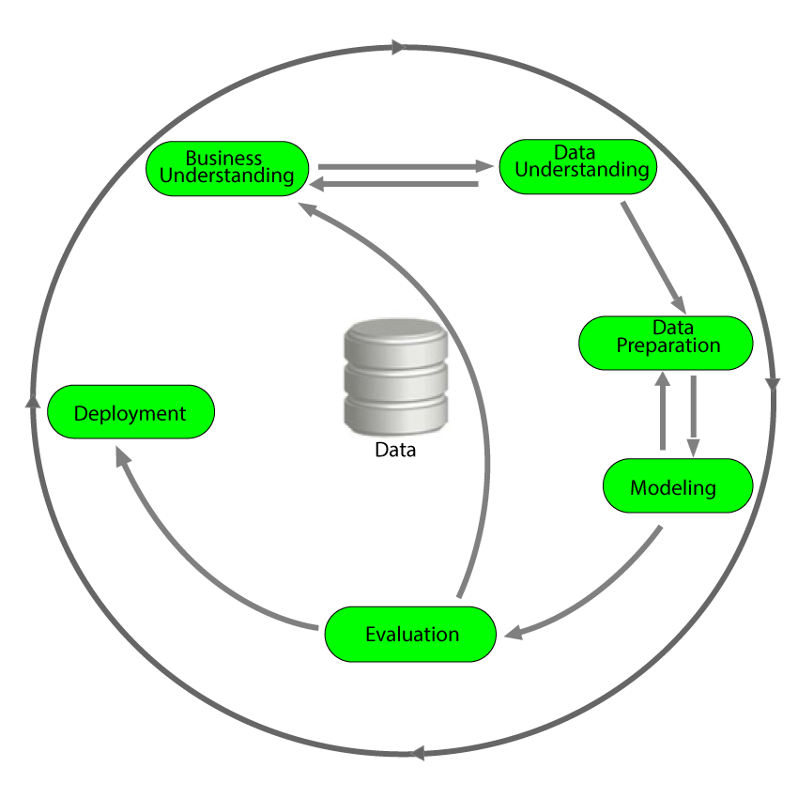
METHODOLOGY
We have used cross-industry standard process for Data mining as our approach for developing facial scan system.
CRISP -DM

Slide 5
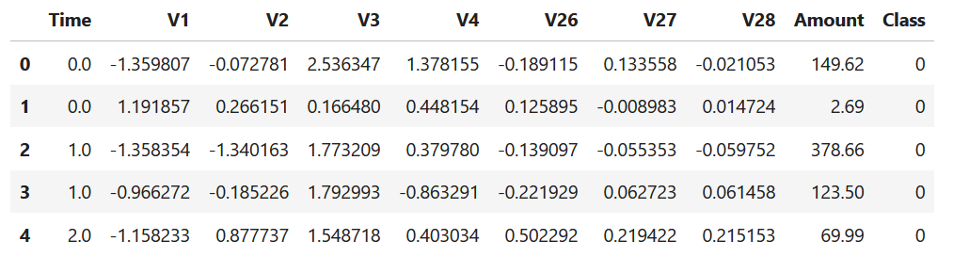
DATASET DESCRIPTION
Dataset has 31 columns, Time is seconds elapsed between each transaction and the first transaction in the dataset, V1 to V28 Principal Components obtained using PCA, Amount value in Euros and Class 0- fraud and 1-genuine.

Slide 6
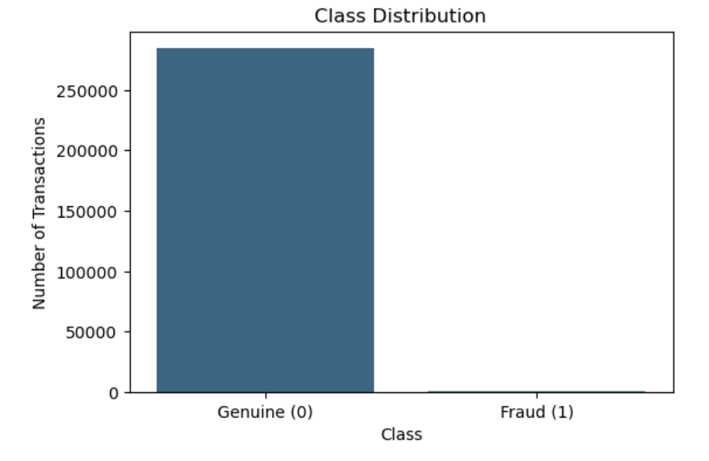
DATA VISUALIZATION
Dataset is imbalanced dataset, as there are 284315 genuine and 492 fraudulent transactions.

Slide 7
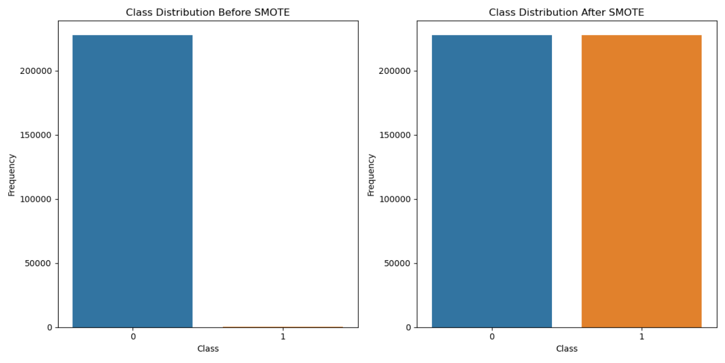
DATA PREPROCESSING
Handling the imbalanced dataset, for a better model training.

Slide 8
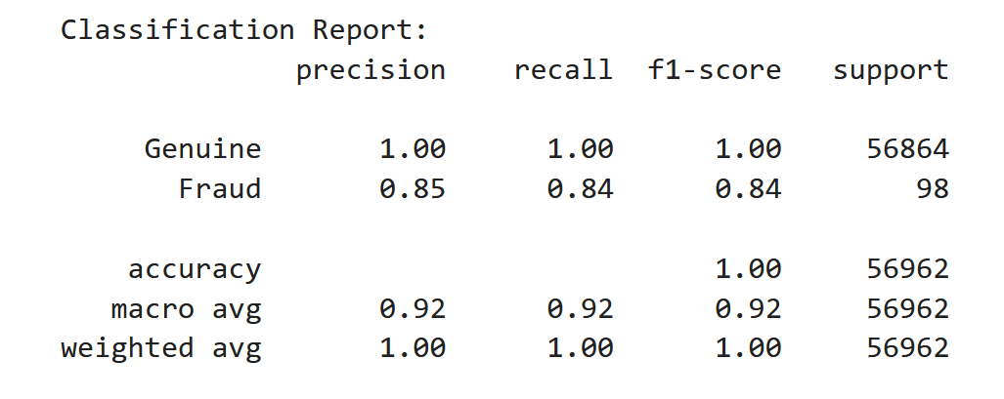

TRAINNIG THE MODEL AND DEPLOYMENT
The model is created using Random Forest with a balanced accuracy of 92% and deploy on flask for the production.

Slide 9
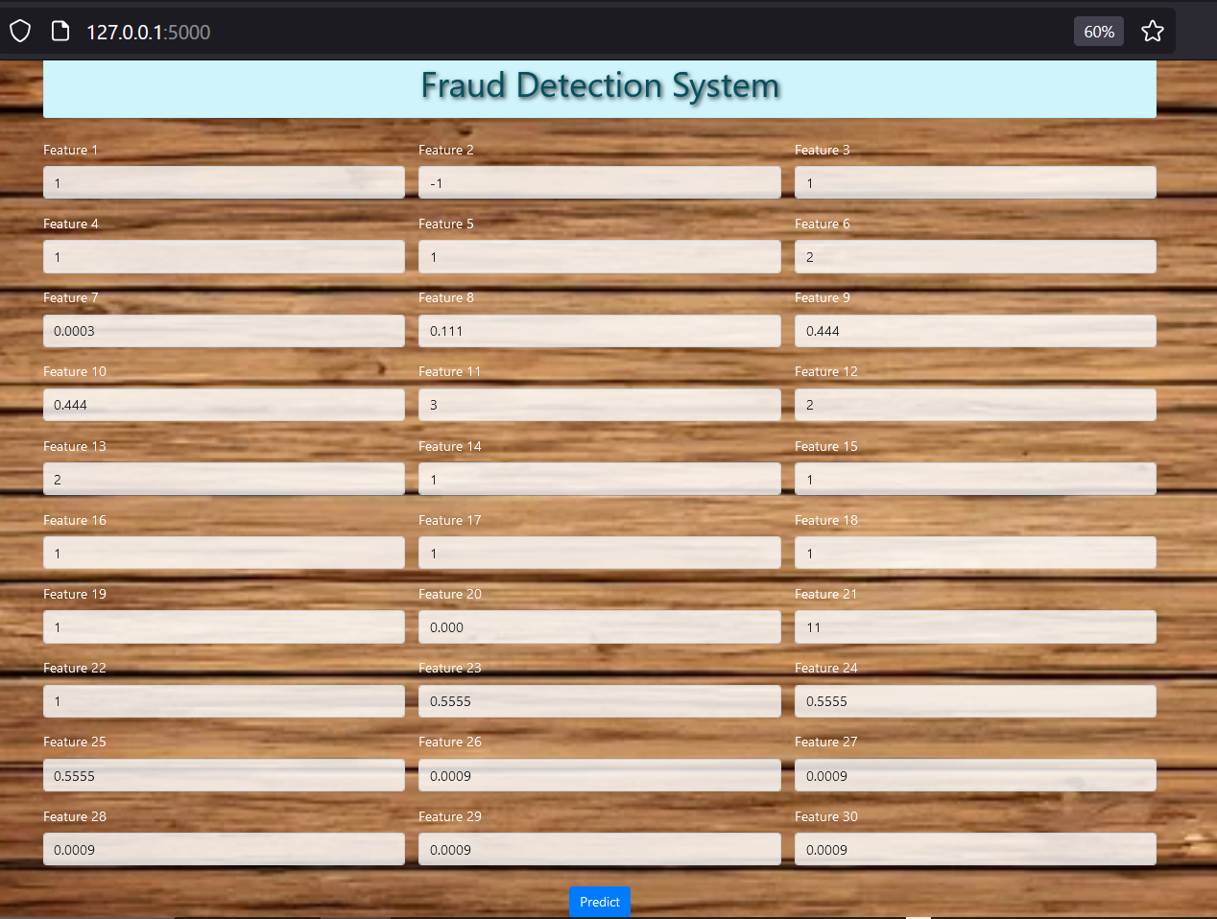
USING DEPLOYED MODEL

Slide 10
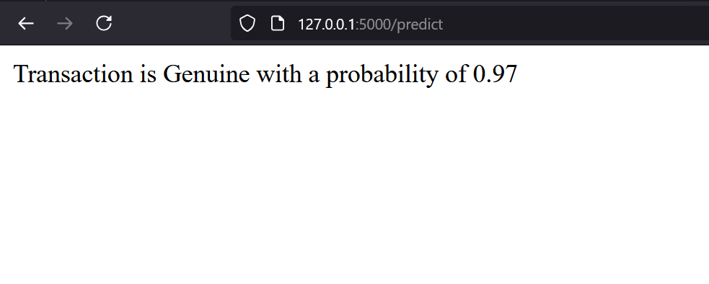
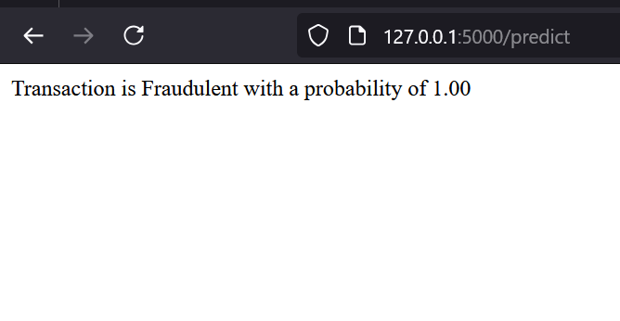
MODEL DEPLOYMENT

Slide 11
CONCLUSION
The manual machine learning model was capable to be put into production and help the bank to identify fraudulent transactions, the bank can use the model and keep on fine tuning it as the use and being on the increasing of new dataset.

Slide 12
THANK YOU

